Slide 1

On Building Predictive Models With H2O

Slide 2
H2O Training
1
Introduction to H2O
4
Hadoop Administration
2
H2O Best Practices [Munging]
5
Sparkling Water
3
H2O Best Practices [Modeling]
6
Productionalizing Models

Slide 3
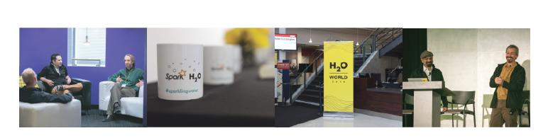
Company Overview
Company
Product
Team: 80. Founded in 2012, Mountain View, CA
Stanford Math & Systems Engineers
Open Source Leader in Machine & Deep learning
Ease of Use and Smarter Applications
R, Python, Spark & Hadoop Interfaces
Expanding Predictions to Mass Analyst markets

Slide 4

Executive Team
Sri Satish Ambati
Tom Kraljevic
Arno Candel
CEO & Co-founder
VP of Engineering
Chief Architect
DataStax
Abrizio, Intel
HPC, CERN
Board of Directors
Scientific Advisory Council
Jishnu Bhattacharjee // Nexus Ventures
Ash Bhardwaj // Flextronics
Trevor Hastie
Stephen Boyd
Rob Tibshirani

Slide 5


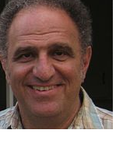
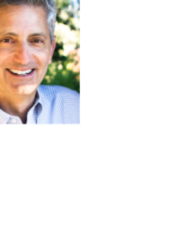
cientific Advisory Council
Dr. Trevor Hastie
PhD in Statistics, Stanford University
John A. Overdeck Professor of Mathematics, Stanford University
Co-author, The Elements of Statistical Learning: Prediction, Inference and Data Mining
Co-author with John Chambers, Statistical Models in S
Co-author, Generalized Additive Models
108,404 citations (via Google Scholar)
Dr. Rob Tibshirani
PhD in Statistics, Stanford University
Professor of Statistics and Health Research and Policy, Stanford University
COPPS Presidents’ Award recipient
Co-author, The Elements of Statistical Learning: Prediction, Inference and Data Mining
Author, Regression Shrinkage and Selection via the Lasso
Co-author, An Introduction to the Bootstrap
Dr. Stephen Boyd
PhD in Electrical Engineering and Computer Science, UC Berkeley
Professor of Electrical Engineering and Computer Science, Stanford University
Co-author, Convex Optimization
Co-author, Linear Matrix Inequalities in System and Control Theory
Co-author, Distributed Optimization and Statistical Learning via the Alternating Direction Method of Multipliers

Slide 6
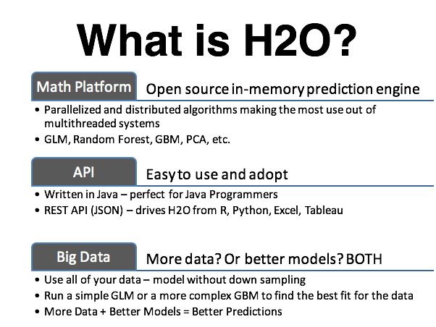

Slide 7
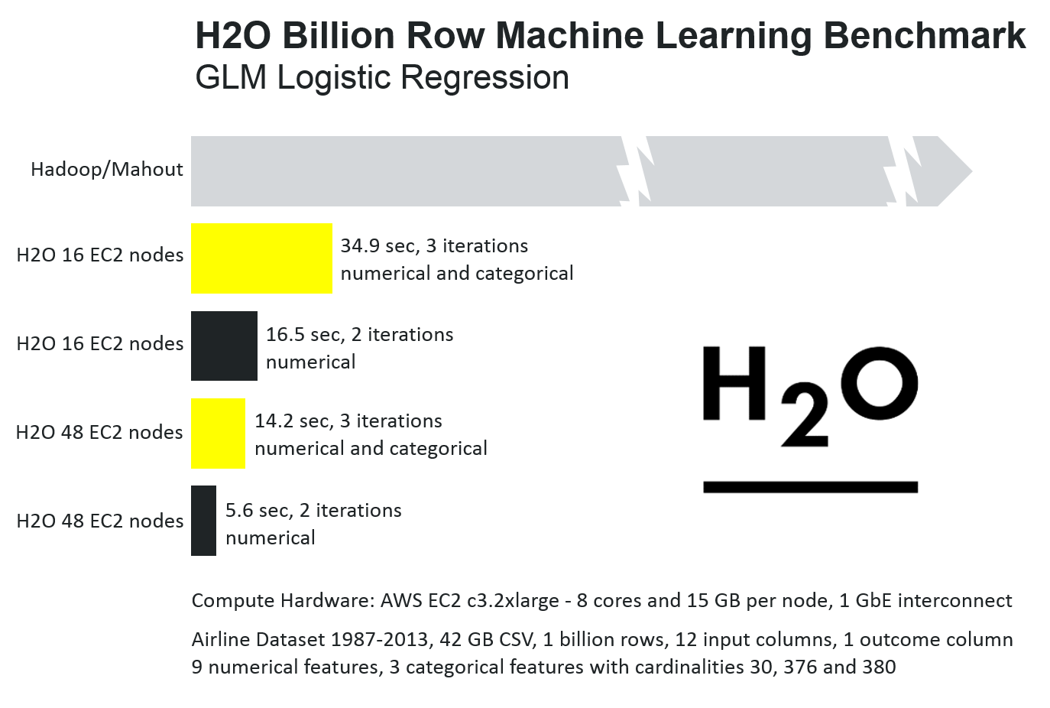
Performance

Slide 8
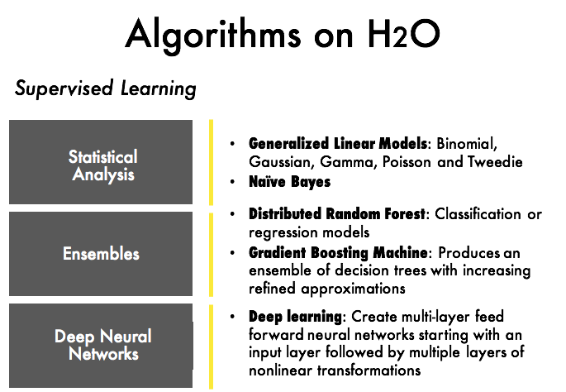

Slide 9


Slide 10
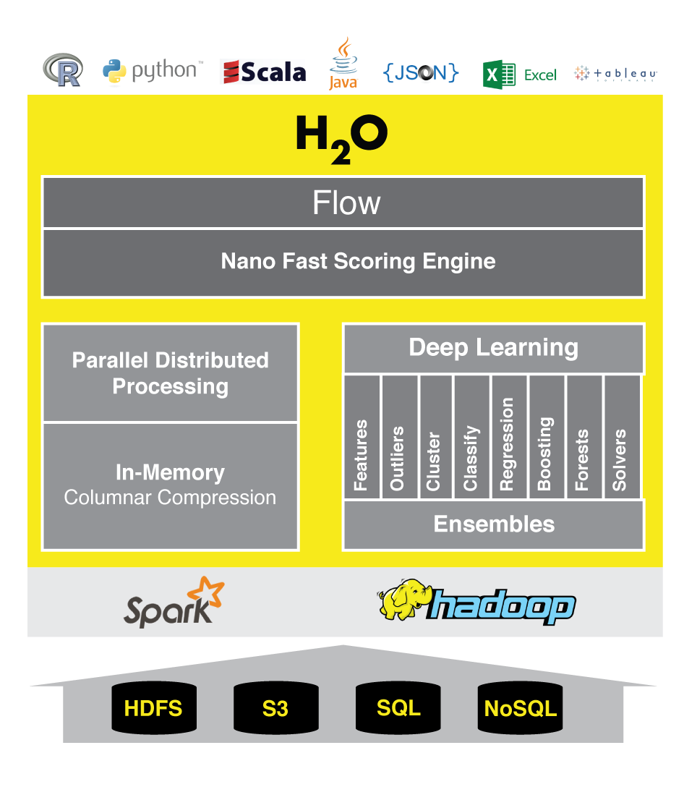
Accuracy with Speed and Scale

Slide 11

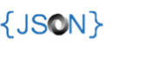






Accuracy with Speed and Scale
HDFS
Fast Modeling Engine
In-Memory
Feature Engineering
Deep Learning
Matrix Factorization
S3
Clustering
Map Reduce/Fork Join
PCA, GLM, Cox
Munging
Classification
Regression
Columnar Compression
Random Forest / GBM Ensembles
SQL
Streaming
Nano Fast Java Scoring Engines
NoSQL

Slide 12

Reading Data into H2O with R
STEP 1
h2o_df = h2o.importFile(“../data/allyears2k.csv”)
R user

Slide 13
Reading Data from HDFS into H2O with R
STEP 2
2.3
Initiate distributed ingest
H2O Cluster
2.2
R
HTTP REST API request to H₂O
has HDFS path
H₂O
H₂O
h2o.importFile()
H₂O
2.1
R function call
2.4
Request data from HDFS
HDFS
data.csv
Notes:
Data never goes into or through R
R tells H2O what to do
R has a pointer to the big data that lives in H2O
Operations on the R object are intercepted using operator overleading and forwarded to H2O via the REST API
H2OFrame object in R is a proxy for the big data in H2O
R: df= H2O.imporrtFile(“hdfs://path/to/data.csv”)
h2o>_df is an H2OFrame object in R

Slide 14
Reading Data from HDFS into H2O with R
STEP 3
3.2
Distributed H₂O
Frame in DKV
H2O Cluster
3.3
R
Return pointer to data in REST API JSON Response
H₂O
h2o_df
H₂O
Frame
H₂O
Cluster IP
Cluster Port
Pointer to Data
H₂O
3.4
h2o_df object created in R
3.1
HDFS provides data
HDFS
data.csv
Notes:
Data never goes into or through R
R tells H2O what to do
R has a pointer to the big data that lives in H2O
Operations on the R object are intercepted using operator overleading and forwarded to H2O via the REST API
H2OFrame object in R is a proxy for the big data in H2O
R: df= H2O.imporrtFile(“hdfs://path/to/data.csv”)
h2o>_df is an H2OFrame object in R

Slide 15
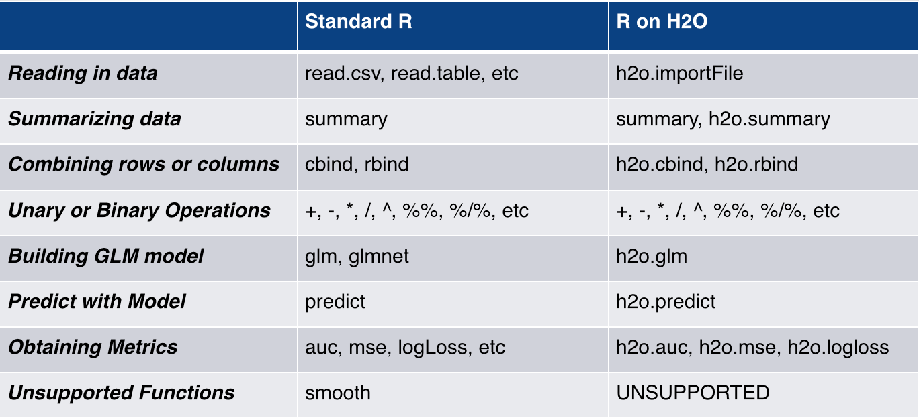
Data Munging in R

Slide 16
R Script Starting H2O GLM
TCP/IP
HTTP
HTTP
Legend
REST/JSON
REST/JSON
/3/ModelBuilders/glm endpoint
Network layer
.h2o.startModelJob()
POST /3/ModelBuilders/glm
Job
REST layer
H2O GLM algorithm
H2O - algos
h2o.glm()
H2O GLM tasks
H2O - core
R script
Fork/Join framework
K/V store framework
User process
Standard R process
H2O Java Process
H2O process

Slide 17
R Script Retrieving H2O GLM Result
TCP/IP
HTTP
HTTP
Legend
REST/JSON
REST/JSON
/3/Models endpoint
Network layer
h2o.getModel()
GET /3/Models/glm_model_id
REST layer
H2O - algos
h2o.glm()
H2O - core
R script
Fork/Join framework
K/V store framework
User process
Standard R process
H2O process
H2O process

Slide 18
H2O Training
1
Introduction to H2O
4
Hadoop Administration
2
H2O Best Practices [Munging]
5
Sparkling Water
3
H2O Best Practices [Modeling]
6
Productionalizing Models

Slide 19
as.h2o() vs. as.data.frame()
as.h2o()
as.data.frame()
Turns R data.frame into an H2OFrame
Saves data.frame to CSV and then performs h2o.upload() to H2O cluster
Turns H2OFrame to R data.frame
Does h2o.downloadCSV and then read.csv, and finally turns it into data.frame
Note: Be mindful of as.data.frame(), it is difficult to make a large H2OFrame into a R data.frame

Slide 20
Column Types: Enum, Numeric, Dates

Slide 21
Enum vs. Numeric vs. Dates
Enum: Also known as enumerated variable. Represents a categorical variable
Enum
Numeric: Variable that holds a numeric value
Numeric
Date: %M%D%Y is automatic format that H2O reads in
Dates

Slide 22
Enum vs. Numeric vs. Dates
Enum
Numeric
Dates
h2o.year(x)
Convert the entries of an H2OFrame object from milliseconds to years, indexed starting from 1900.
as.factor(x)
Used to convert given variable to an enumerated type variable
as.numeric(x)
Used to convert given variable to an numeric variable
h2o.month(x)
Converts the entries of an H2OFrame object from milliseconds to months (on a 1 to 12 scale).

Slide 23
Filters & Logics

Slide 24
Filters & Logics
h2o.ifelse(test, yes, no)
Arguments
Note: Only numeric values can be tested, and only numeric results can be returned.
test
yes
no
A logical description of the condition to be met (>, <, =, etc…)
The value to return if the condition is TRUE.
The value to return if the condition is FALSE.

Slide 25
Summary & Aggregation

Slide 26
Summary & Aggregation
h2o.group_by(data, by, ..., gb.control = list(na.methods = NULL, col.names = NULL))
Arguments
data
by
gb.control
. . .
an H2OFrame object.
a list of column names
a list of how to handle NA values in the dataset as well as how to name output columns
Any supported aggregated function: mean, min, max, sum, sd, nrow

Slide 27
Summary & Aggregation
h2o.table(x, y = NULL, dense = TRUE)
Arguments
x
y
dense
An H2OFrame object with at most two columns
An H2OFrame similar to x, or NULL
A logical for dense representation, which lists only non-zero counts, 1 combination per row. Set to FALSE to expand counts across all combinations.
Value: Returns a tabulated H2OFrame Object

Slide 28
String Munging

Slide 29
String Munging
h2o.impute(data, column = 0, method = c(“mean", "median", “mode"), combine_method c("interpolate","average", "lo", "hi"), by = NULL, groupByFrame = NULL, values = NULL)
Arguments
data
column
method
combine_method
by
groupByFrame
values
The dataset containing the column to impute.
The column to impute.
“mean" replaces NAs with the column mean; "median" replaces NAs with the
column median; "mode" replaces with the most common factor (for factor columns only)
If method is "median", then choose how to combine quantiles on even sample
sizes. This parameter is ignored in all other cases
Group by columns
Impute the column col with this pre-computed grouped frame.
A vector of impute values (one per column). NaN indicates to skip the column

Slide 30
String Munging
Substitute pattern match w/replacement
h2o.gsub()
h2o.sub()
String Cleaning
h2o.substring()
h2o.strsplit()
h2o.trim()
h2o.rstrip() & h2o.lstrip()
h2o.interaction()

Slide 31
Demo Time

Slide 32
H2O Training
1
Introduction to H2O
4
Hadoop Administration
2
H2O Best Practices [Munging]
5
Sparkling Water
3
H2O Best Practices [Modeling]
6
Productionalizing Models

Slide 33
1. Train vs Test
Training Set vs.
Test Set
Partition the original data (randomly or stratified) into a training set and a test set. (e.g. 70/30)
Training Error vs.
Test Error
It can be useful to evaluate the training error, but you should not look at training error alone.
Training error is not an estimate of generalization error (on a test set or cross-validated), which is what you should care more about.
Training error vs test error over time is an useful thing to calculate. It can tell you when you start to overfit your model, so it is a useful metric in supervised machine learning.

Slide 34

2. Train vs Test vs Valid
Training Set vs.
Validation Set vs.
Test Set
If you have “enough” data and plan to do some model tuning, you should really partition your data into three parts — Training, Validation and Test sets.
There is no general rule for how you should partition the data and it will depend on how strong the signal in your data is, but an example could be: 50% Train, 25% Validation and 25% Test
Validation is for Model Tuning
The validation set is used strictly for model tuning (via validation of models with different parameters) and the test set is used to make a final estimate of the generalization error.

Slide 35
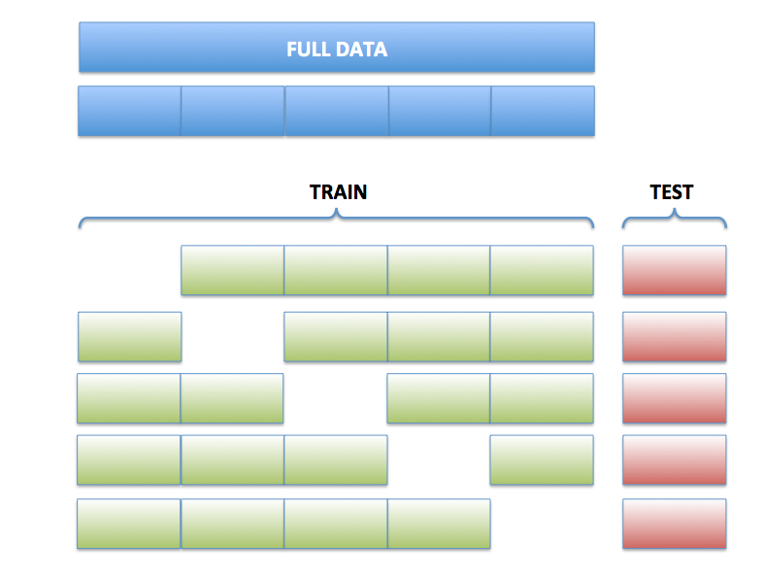
3. Model Performance
Test Error
Partition the original data (randomly) into a training set and a test set. (e.g. 70/30)
Train a model using the training set and evaluate performance (a single time) on the test set.
K-fold
Cross-validation
Train & test K models as shown.
Average the model performance over the K test sets.
Report cross-validated metrics.
Performance Metrics
Regression: R^2, MSE, RMSE
Classification: Accuracy, F1, H-measure, Log-loss
Ranking (Binary Outcome): AUC, Partial AUC

Slide 36
4. Class Imbalance
Imbalanced Response Variable
A dataset is said to be imbalanced when the binomial or multinomial response variable has one or more classes that are underrepresented in the training data, with respect to the other classes.
Very common
This is incredibly common in real-word datasets.
In practice, balanced datasets are the rarity, unless they have been artificially created.
There is no precise definition of what defines an imbalanced vs balanced dataset — the term is vague.
My rule of thumb for binary response: If the minority class makes <10% of the data, this can cause issues.
Industries
Advertising — Probability that someone clicks on ad is very low… very very low.
Healthcare & Medicine — Certain diseases or adverse medical conditions are rare.
Fraud Detection — Insurance or credit fraud is rare.

Slide 37
4. Remedies
Artificial Balance
You can balance the training set using sampling.
Potential Pitfalls
Notice that we don’t say to balance the test set. The test set represents the true data distribution. The only way to get “honest” model performance on your test set is to use the original, unbalanced, test set.
The same goes for the hold-out sets in cross-validation. For this, you may end up having to write custom code, depending on what software you use.
H2O has a “balance_classes” argument that can be used to do this properly & automatically.
You can manually upsample (or downsample) your minority (or majority) class(es) set either by duplicating (or sub-sampling) rows, or by using row weights.
Solutions

Slide 38
5. Categorical Data
Real Data
Most real world datasets contain categorical data.
Too Many Categories
Problems can arise if you have too many categories.
A lot of ML software will place limits on the number of categories allowed in a single column (e.g. 1024) so you may be forced to deal with this whether you like it or not.
When there are high-cardinality categorical columns, often there will be many categories that only occur a small number of times (not very useful).
Solutions
If you have some hierarchical knowledge about the data, then you may be able to reduce the number of categories by using some sensible higher-level mapping of the categories.
Example: ICD-9 codes — thousands of unique diagnostic and procedure codes. You can map each category to a higher level super-category to reduce the cardinality.

Slide 39
6. Missing Data
Types of
Missing Data
Unavailable: Valid for the observation, but not available in the data set.
Removed: Observation quality threshold may have not been reached, and data removed
Not applicable: measurement does not apply to the particular observation (e.g. number of tires on a boat observation)
What to Do
It depends! Some options:
Ignore entire observation.
Create an binary variable for each predictor to indicate whether the data was missing or not
Segment model based on data availability.
Use alternative algorithm: decision trees accept missing values; linear models typically do not.

Slide 40
7. Outliers/Extreme Values
Types of Outliers
Outliers can exist in response or predictors
Valid outliers: rare, extreme events
Invalid outliers: erroneous measurements
What Can
Happen
Outlier values can have a disproportionate weight on the model.
MSE will focus on handling outlier observations more to reduce squared error.
Boosting will spend considerable modeling effort fitting these observations.
Remove observations.
Apply a transformation to reduce impact: e.g. log or bins.
Choose a loss function that is more robust: e.g. MAE vs MSE.
Impose a constraint on data range (cap values).
Ask questions: Understand whether the values are valid or invalid, to make the most appropriate choice.
What to Do

Slide 41
8. Data Leakage
What Is It
Leakage is allowing your model to use information that will not be available in a production setting.
Obvious example: using the Dow Jones daily gain/loss as part of a model to predict individual stock performance
What Happens
Model is overfit.
Will make predictions inconsistent with those you scored when fitting the model (even with a validation set).
Insights derived from the model will be incorrect.
What to Do
Understand the nature of your problem and data.
Scrutinize model feedback, such as relative influence or linear coefficient.

Slide 42
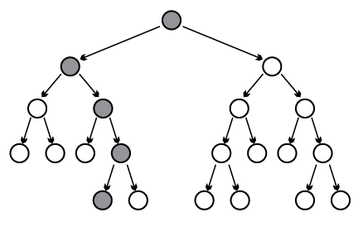
Algorithm Spotlight:
Gradient Boosting Machine

Slide 43
When to use GBM?
What is GBM?
An ensemble of weak learners. The decision trees in GBM are built consecutively, with each new layer solving for the net loss of prior trees. This means the algorithm is inherits the pros of building decision trees while also making up for poor accuracy by creating an ensemble of trees that learn from prior trees.
Strengths
Nonlinear models
Robust to correlated features
Robust to feature distributions
Robust to missing values
Weaknesses
Tends to overfit on the training set
Sensitive to noise and outliers

Slide 44
GBM Functionalities in H2O
Regression and Classification Models Exponential distributions including Poisson, Gamma, and Tweedie are available in addition to Bernoulli, multinomial, and gaussian distributions.
Fast and CPU Efficient Parallel and distributed computation across multiple nodes and many cores.
Grid Search Hyperparameter optimization allows the user to run through many parameters before selecting the best models.
Early Stopping The user can specify the metric and the incremental change in the metric as convergence. If additional trees no longer provide an increase in AUC prune the tree early.
Stochastic User can specify the sample rate that the algorithm will sample the column and row by for better generalization.
Model Output The model is exportable as Java code and if you find the model overfitted after a certain number of trees, it is easy to reduce the number of trees in a POJO before putting it in production without rerunning model build.

Slide 45
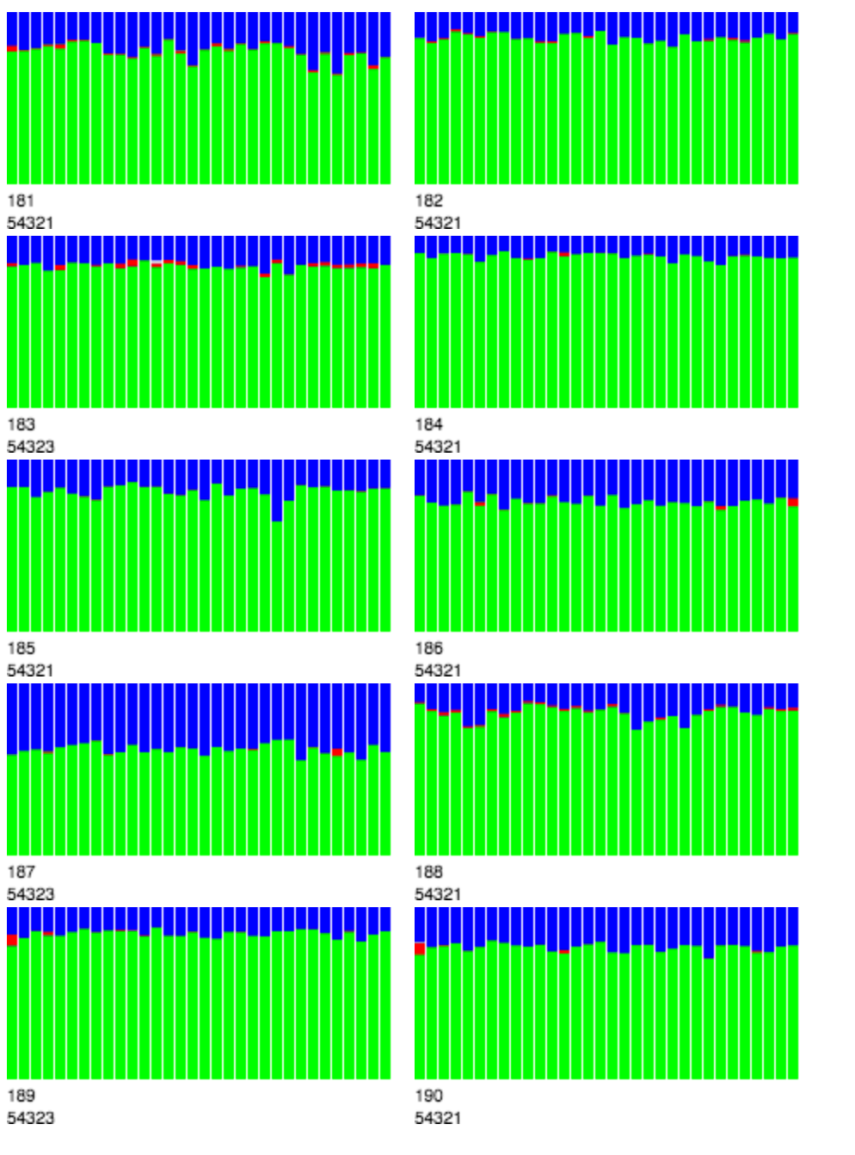
Implementation in H2O
Map vectors to leaves of a tree by assigning a Node ID to each row in the dataset.
We make a split point decision that will move rows of the data down two internal leave nodes.
On each pass through the data, each observation starts at an internal tree node. As we move the observation down the decision tree into a new leaf we record the new Node ID for next pass.
We then collect the summaries from all the split decisions and pick the feature and the split point with the least variance.
By repeating this process we move all the data down the decision trees assigning it new Node IDs along the way and collecting histograms for all the rows. At the end we can split each current leaf and finish building a layer and we repeat for each layer. After one tree is built we start on the next tree.
We run completely parallel and distributed within a single tree level with an upper bound on the tree building rate which is capped at the latency to build a single level as described above.

Slide 46
Parameter Explanation
Binning
Traditionally split points are chosen by sorting the each feature and inspecting an induced split.
For big data even when running parallel and distributed this can be computationally expensive so we approximate sorting with binning.
More Bins, More Accurate The number of bins can be specified by the user and it is the minimum number of bins required in a histogram built for each feature.
Binning Categorical Features
Too Many Levels We run the issue of slow model builds by inducing splits by each level so again we choose to bin the levels in a categorical column.
To try each and every level in a column you will need to specify bins_cat to be the cardinality of the column.
More Bins, More Likely To Overfits Increasing the number of bins can lead to perfect splits by a single level, this reduces the randomness of grouped factors. The model can split more finely then it should on the training set and start to overfit on the validation set.

Slide 47
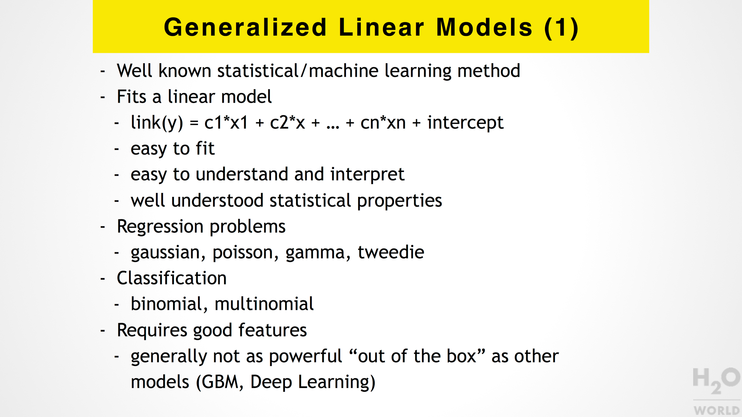

Slide 48
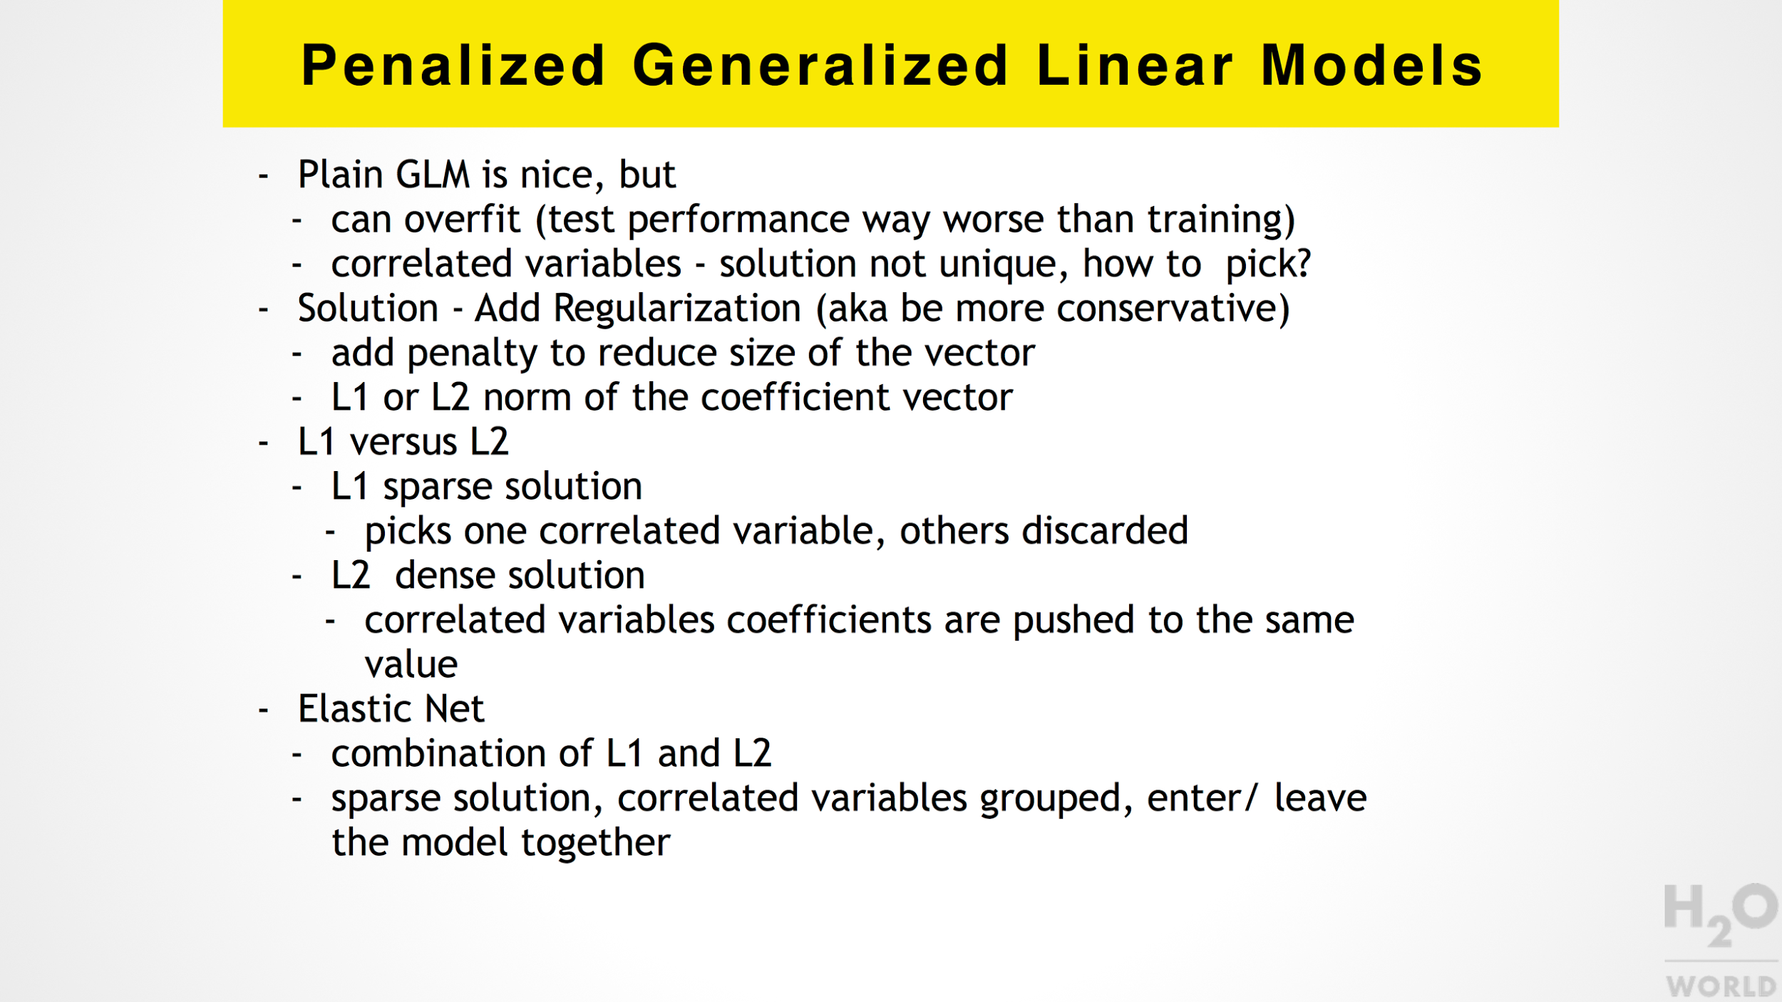

Slide 49
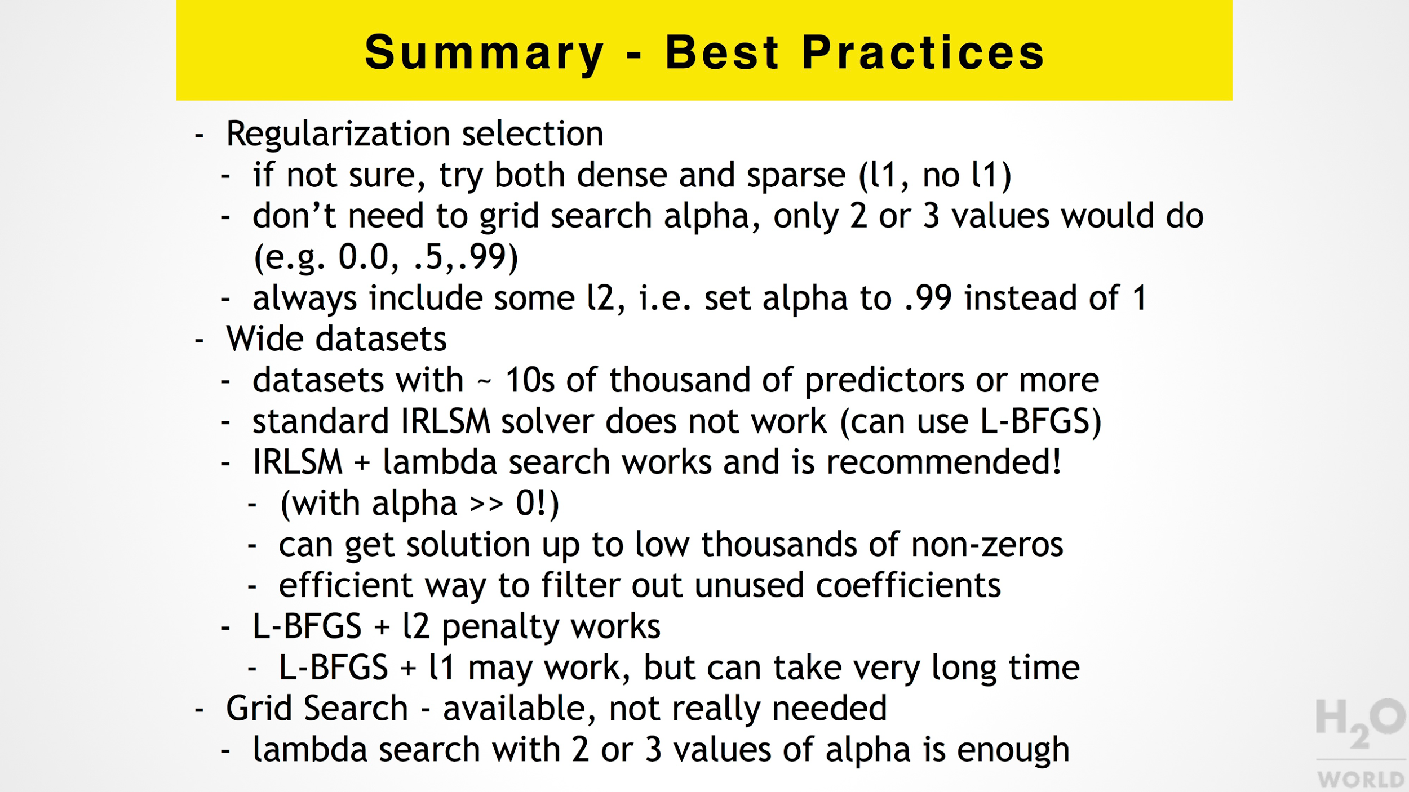

Slide 50
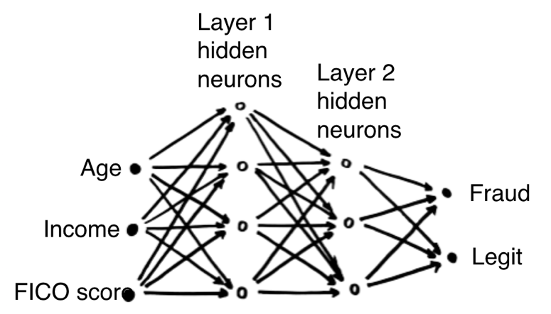
What is Deep Learning?
Deep Learning learns a hierarchy of non-linear transformations
Neurons transform their input in a non-linear way
Black-box, brute-force method, really good at pattern recognition
Deep Learning got a boost in the last decade due to faster hardware and algorithmic advances
Deep Learning model
=
set of connecting
weights
+
type of non-linearity

Slide 51
Deep Learning: Practical Use
strengths
weaknesses
non linear
robust to correlated features
conceptually simple
learned features can be extracted
can stop training at any time
can be fine-tuned with more data
great ensemble member
efficient for multi-class problems
world-class at pattern recognition
slow to train
slow to score
not interpretable
results not fully reproducible
theory not well understood
overfits, needs regularization
many hyper-parameters
expands categorical variables
must impute missing values

Slide 52
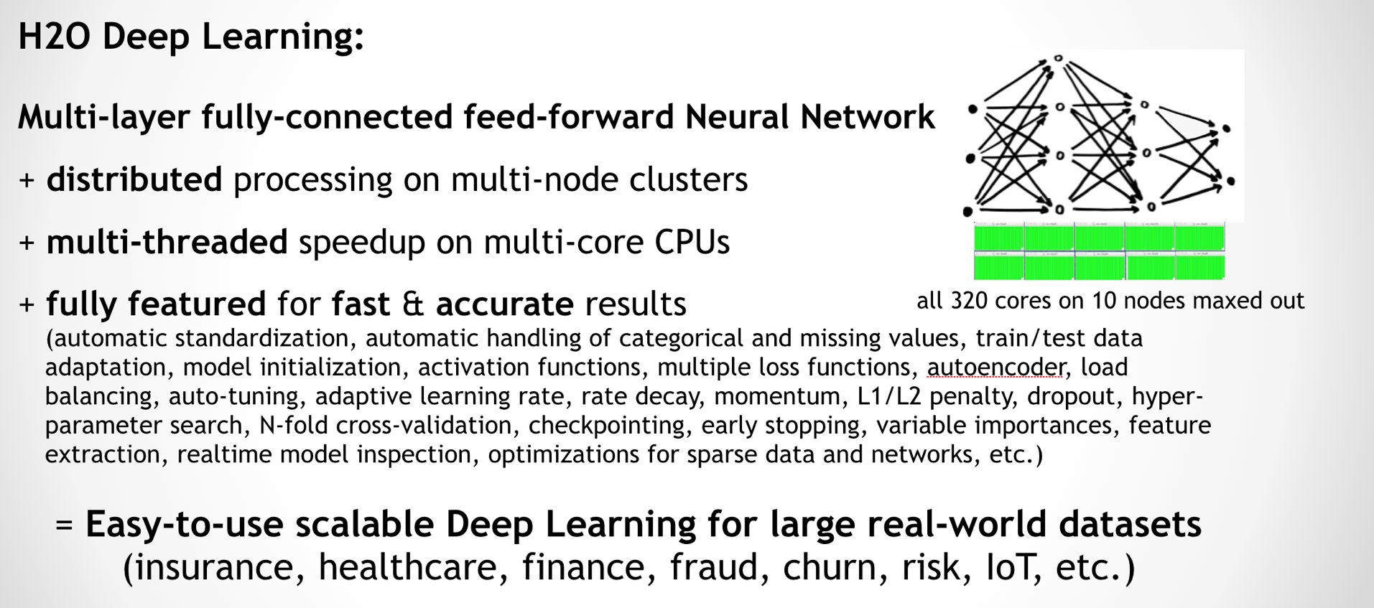
What is H2O Deep Learning?

Slide 53
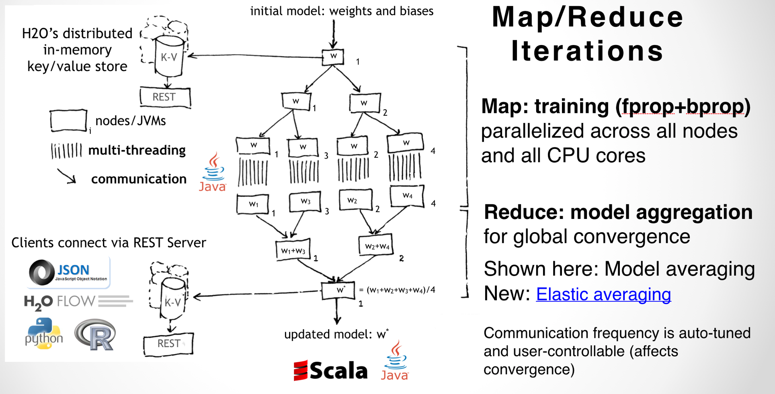
H2O Deep Learning Architecture

Slide 54
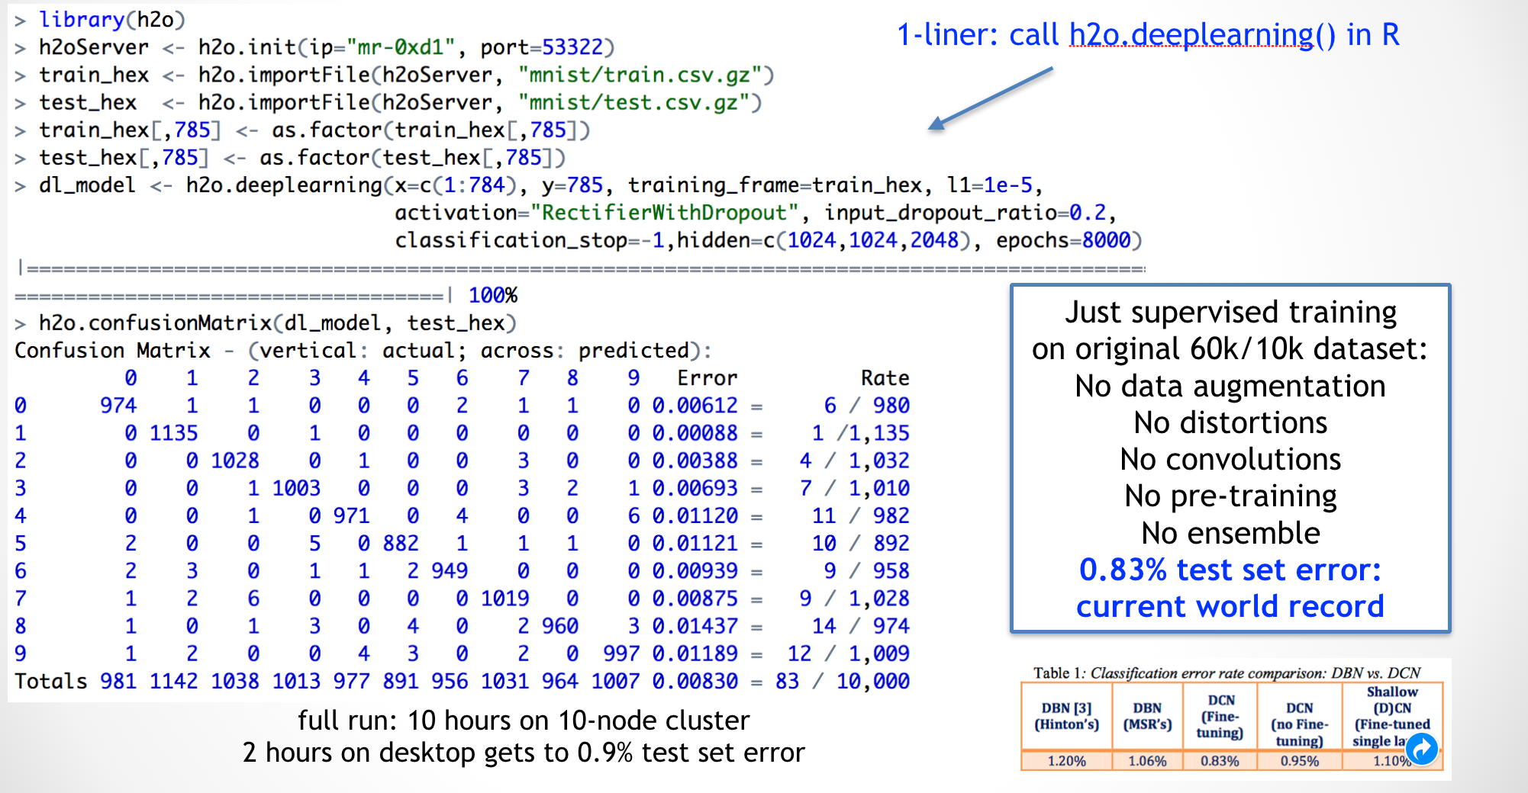
H2O Deep Learning on MNIST -
World-record results

Slide 55
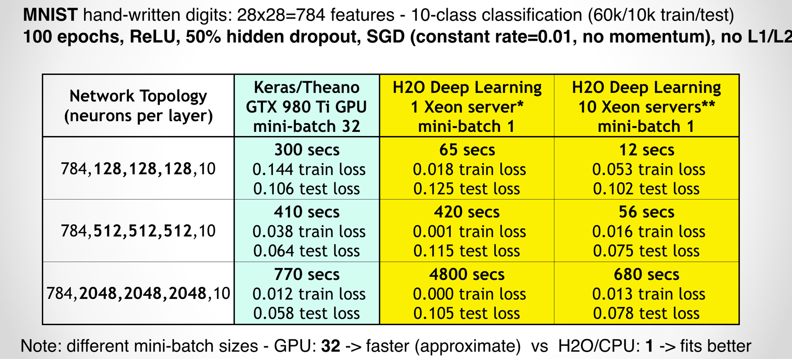
H2O Deep Learning Performance Benchmark
*Dual E5-2650 (8 cores, 2.6GHz), 10GbE **10 model averaging steps

Slide 56
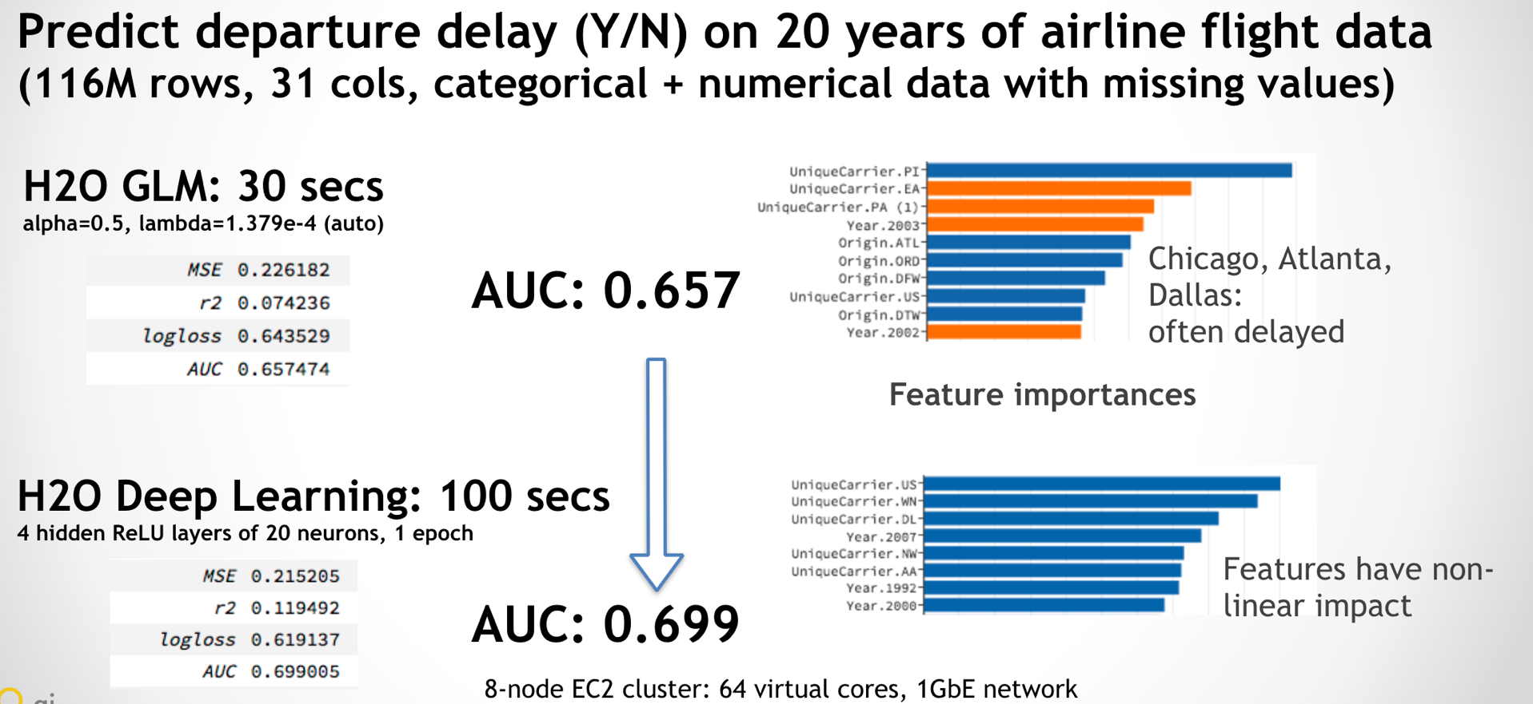
Significant Performance Gains with Deep Learning

Slide 57
H2O Training
1
Introduction to H2O
4
Hadoop Administration
2
H2O Best Practices [Munging]
5
Sparkling Water
3
H2O Best Practices [Modeling]
6
Productionalizing Models

Slide 58
H2O on Hadoop (and Yarn)
On Demand H2O launches as a mapper task that never reduces. User only needs permission to launch map reduce task in order to spin up their own H2O cluster:
hadoop jar h2odriver.jar -nodes 10 -mapperXmx 50g
Update frequently The installation of H2O is essentially a jar file so in order to upgrade the user only needs to download a new driver jar file.
Yarn to manage resources Special queues can be allocated to users to manage the containers and memory allowed.
Access to HDFS and Hive Tables H2O can be built with any distribution’s class libraries to allow access to HDFS whether launched with Yarn or in standalone mode.

Slide 59
H2O on YARN Deployment
Hadoop Gateway Node
Hadoop Cluster
hadoop jar h2odriver.jar …
YARN RM
YARN Worker Nodes
YARN Node
Managers (NM)
NM
NM
NM
NM
NM
NM
H2O Mappers
(YARN Containers)
H₂O
H₂O
H₂O
HDFS
Data Nodes
HDFS

Slide 60
Now You Have an H2O Cluster
Hadoop Gateway Node
Hadoop Cluster
hadoop jar h2odriver.jar …
YARN RM
YARN Worker Nodes
YARN Node
Managers (NM)
NM
NM
NM
H2O Mappers
(YARN Containers)
H₂O
H₂O
H₂O
HDFS
Data Nodes
HDFS

Slide 61
Read Data from HDFS Once
Hadoop Gateway Node
Hadoop Cluster
hadoop jar h2odriver.jar …
YARN RM
YARN Worker Nodes
YARN Node
Managers (NM)
NM
NM
NM
H2O Mappers
(YARN Containers)
H₂O
H₂O
H₂O
HDFS
Data Nodes
HDFS

Slide 62
Build Models in-Memory
Hadoop Gateway Node
Hadoop Cluster
hadoop jar h2odriver.jar …
YARN RM
YARN Worker Nodes
YARN Node
Managers (NM)
NM
NM
NM
H2O Mappers
(YARN Containers)
H₂O
H₂O
H₂O

Slide 63
H2O Training
1
Introduction to H2O
4
Hadoop Adminstration
5
sp
2
H2O Best Practices [Munging]
Sparkling Water
3
H2O Best Practices [Modeling]
6
Productionalizing Models

Slide 64
What is Sparkling Water?
Provides
Transparent integration of H2O with Spark ecosystem
Transparent use of H2O data structures and algorithms with Spark API
Excels in existing Spark workflows requiring advanced Machine Learning algorithms
Smarter ML
Applications
Platform for building

Slide 65
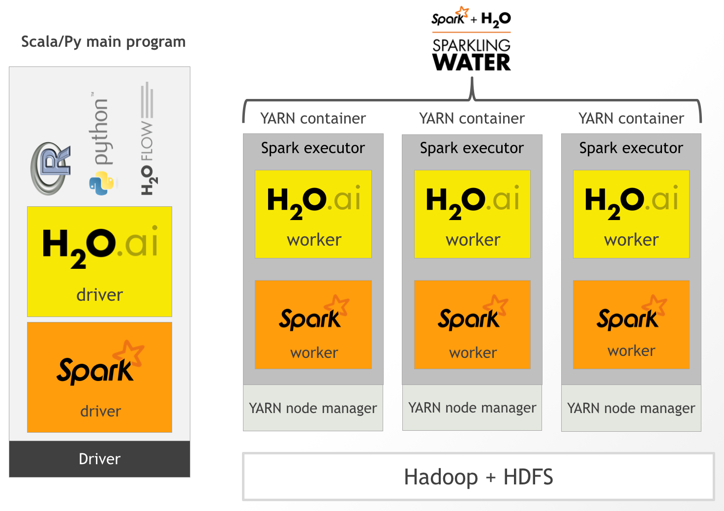
What is Sparkling Water?

Slide 66
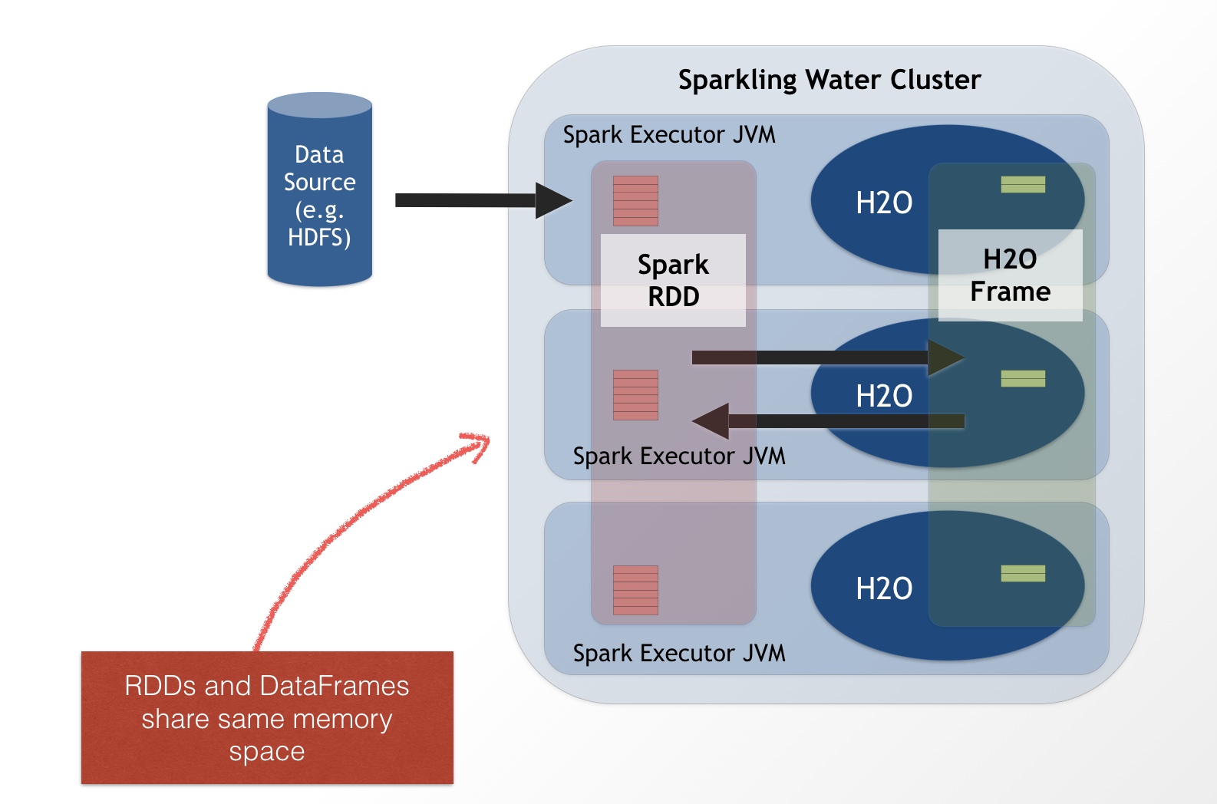
Spark and H2O Data Sharing

Slide 67
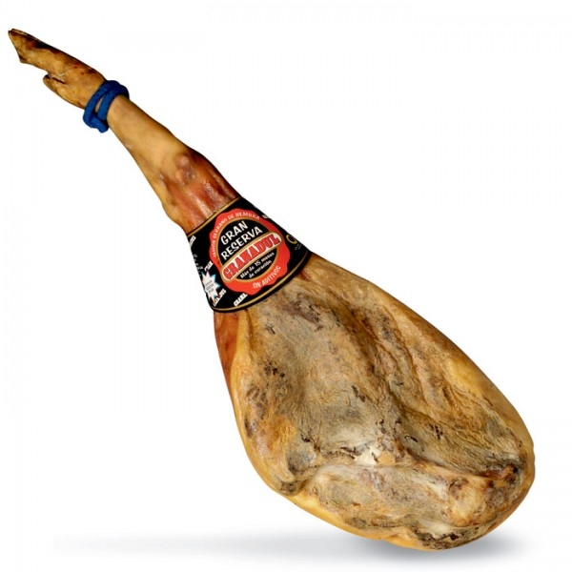
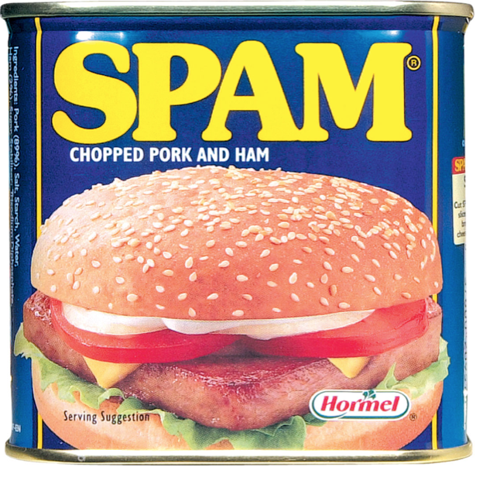
Simple Spam Detector
OR
Detect spam text messages

Slide 68
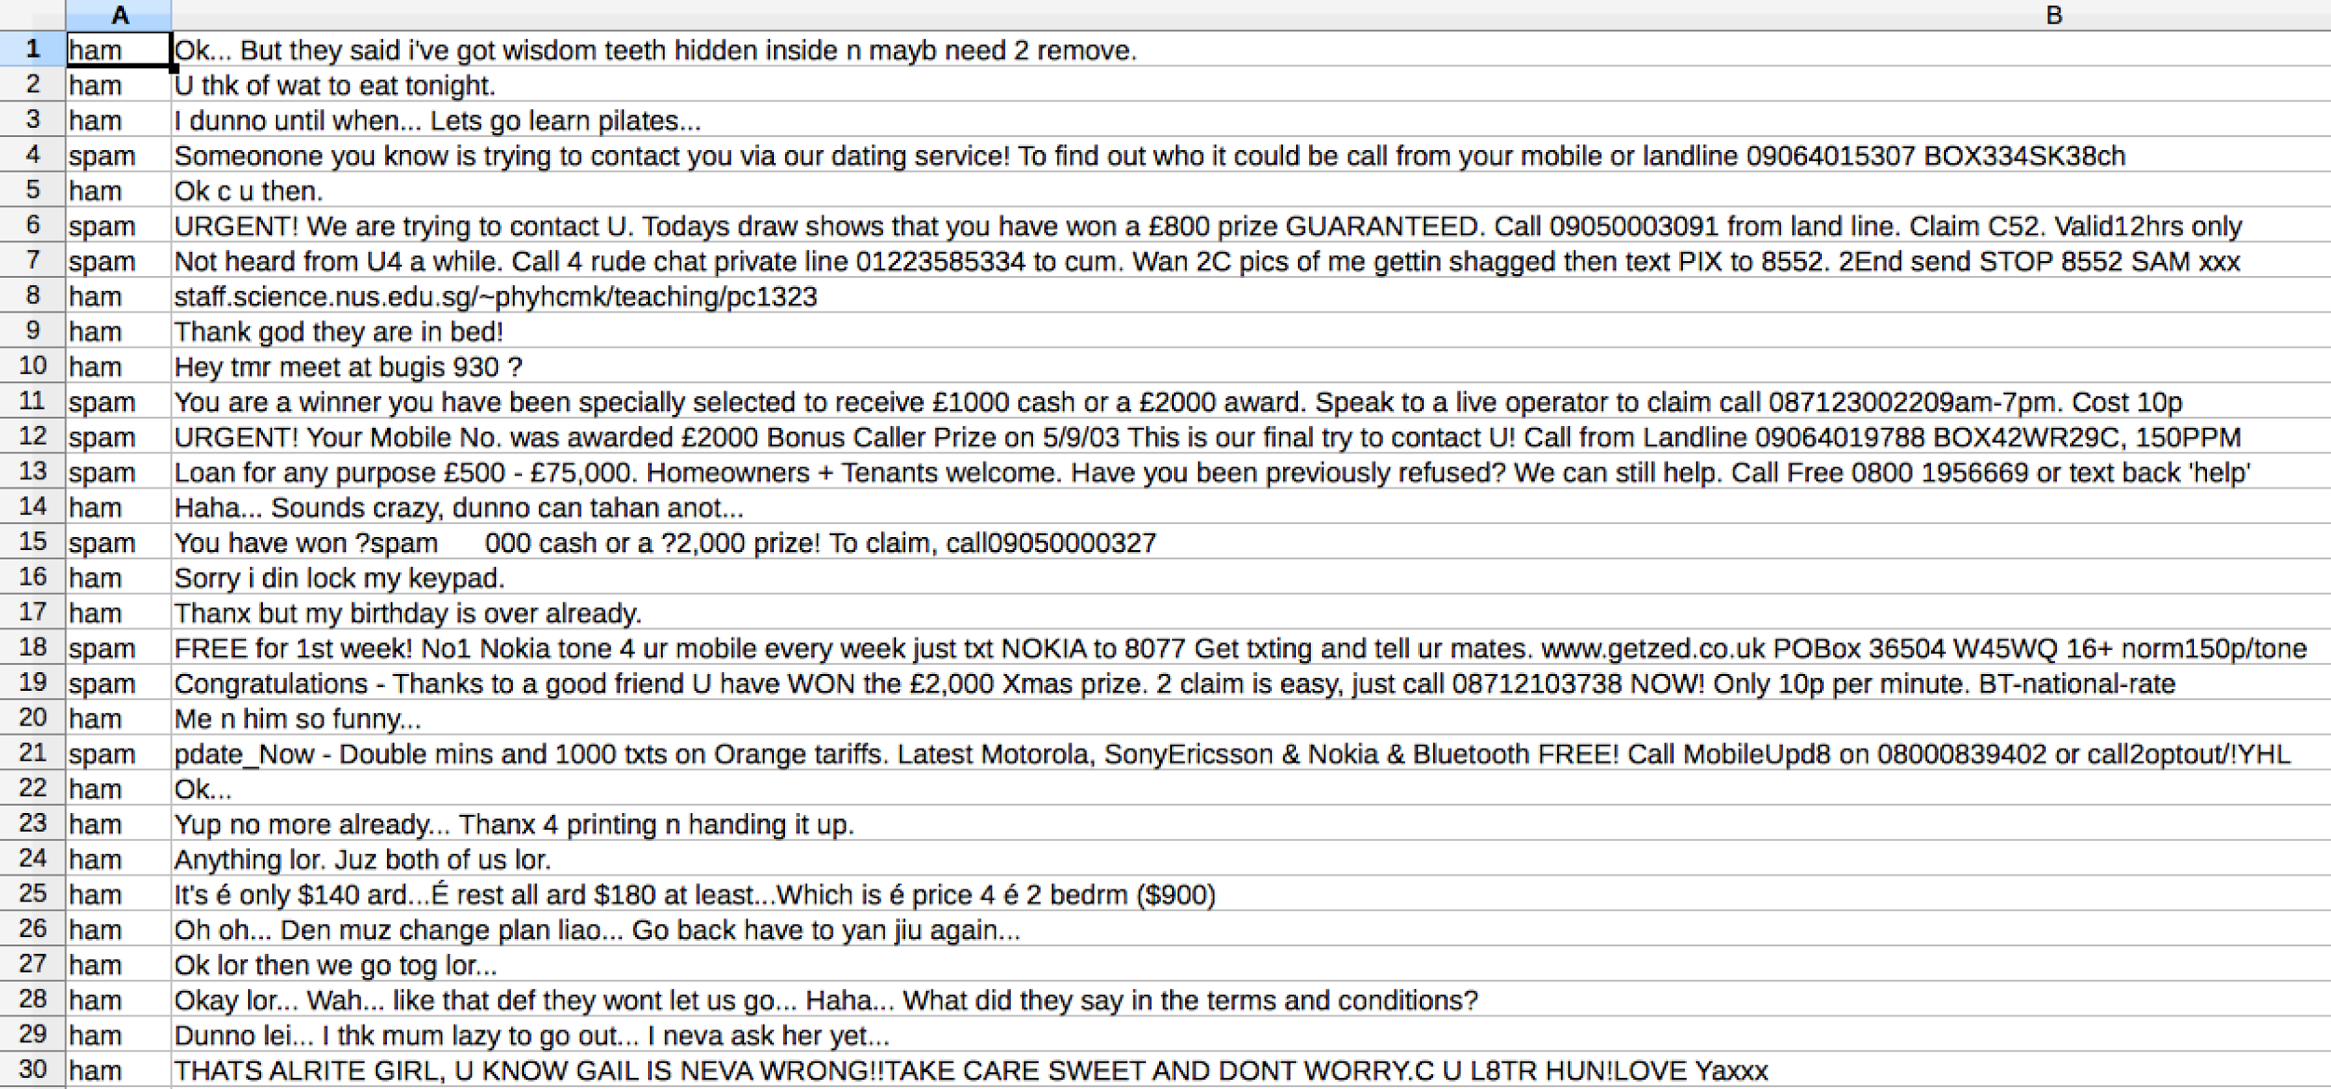
Data example

Slide 69
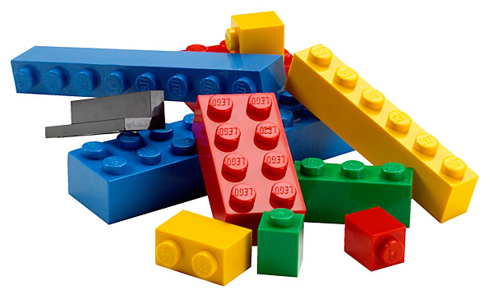
ML Workflow
Goal: For a given text message identify if it is spam or not
Extract data
Transform, tokenize messages
Build Tf-IDF model
Create and evaluate Deep Learning model
Use the model to detect spam

Slide 70
Demo:
Sparkling Shell
Sparkling Water in Flow

Slide 71
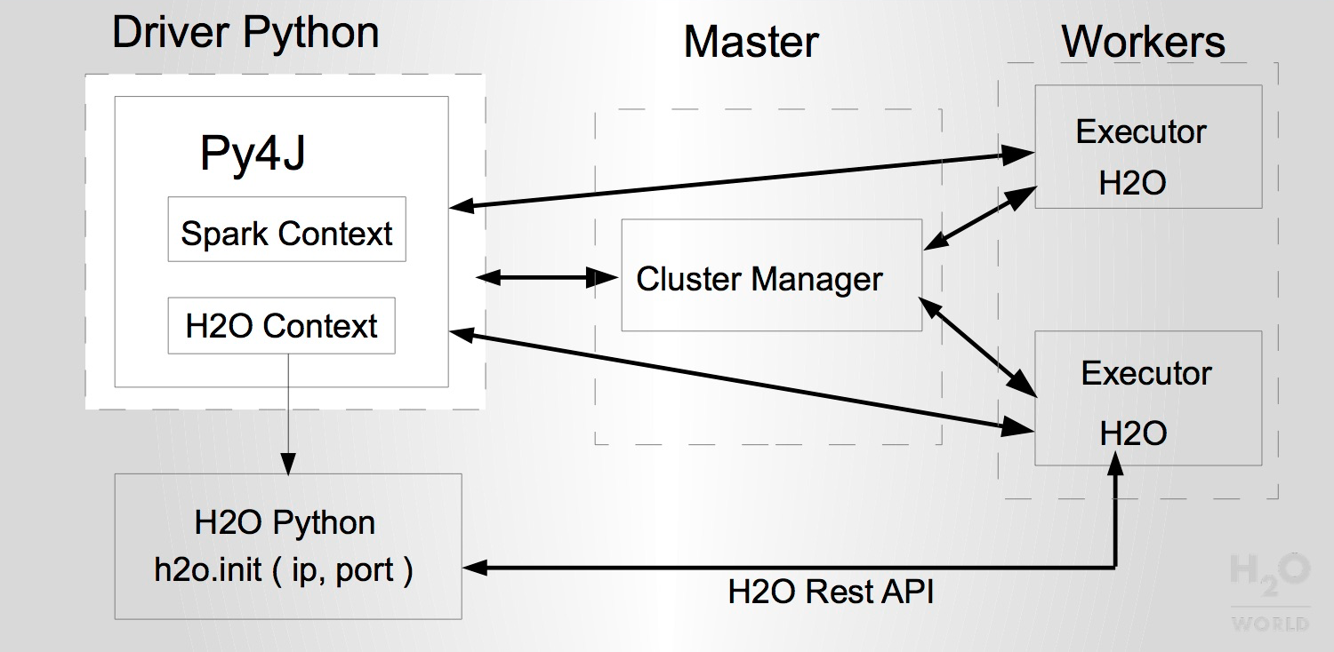
PySparkling Architecture

Slide 72
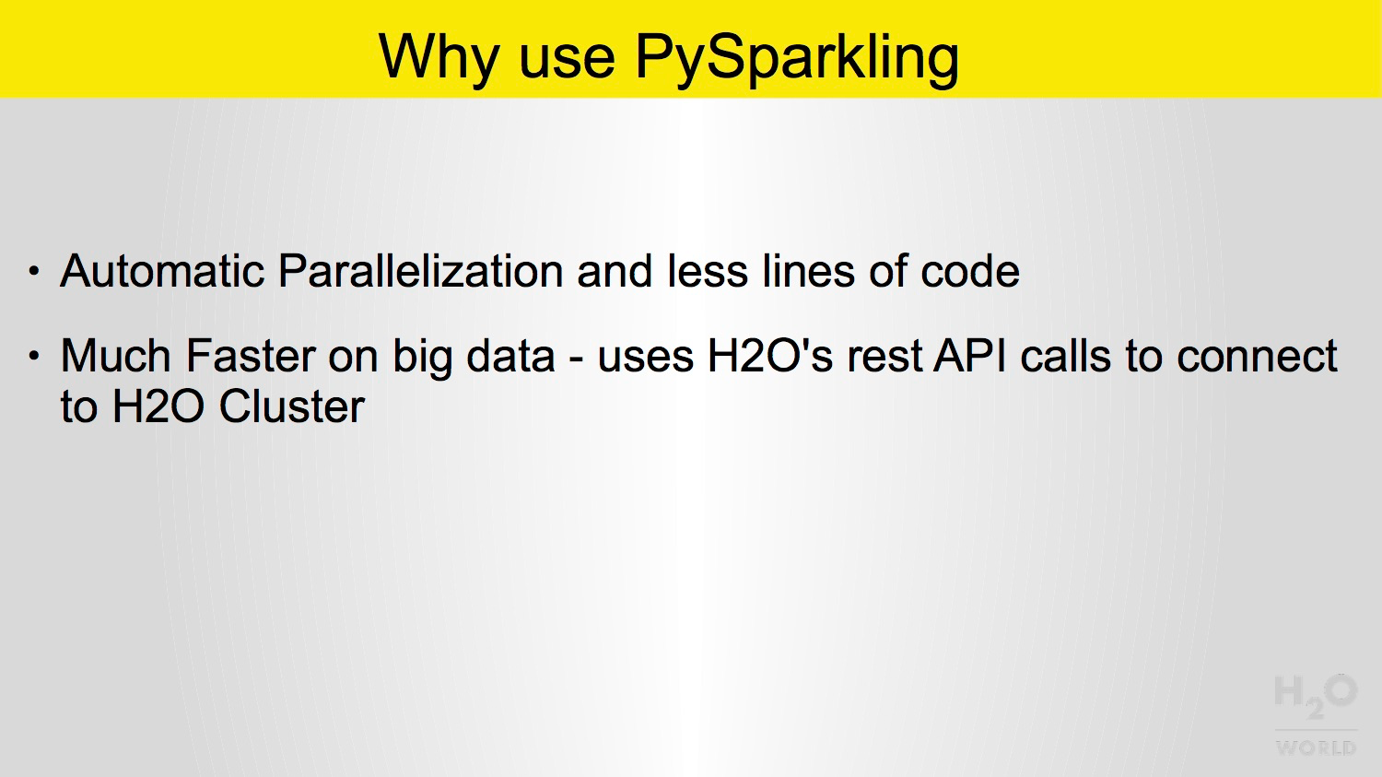

Slide 73
Demo:
PySparkling With Chicago Crime Data

Slide 74
H2O Training
1
Introduction to H2O
4
Hadoop Adminstration
2
H2O Best Practices [Munging]
5
Sparkling Water
3
6
sp
H2O Best Practices [Modeling]
Productionalizing Models

Slide 75
The Problem
Goal:
Move from prototype to production
Road block:
Prototyping Environment Cages Your:
Feature preprocessing
Models
Ideas

Slide 76
Lending Club Dataset
Loan data from 2007 up until 2015 including rejected applications and accepted applications.
Of the 500k accepted applicants about 160k loans have either been completely paid off or defaulted.
There are about 4million applicants in the rejected loans dataset.
Use Case 1 Predict the likelihood of a user defaulting based on the information supplied when applying for a loan.
Use Case 2 Determine the interest rate Lending Club would have offered the user based on the information supplied when applying for a loan.
Use Case 3 Based on the subset of information available in both rejected and accepted loans, predict the likelihood Lending Club will approve your loan request.

Slide 77
Data Dictionary
Predictor Variable | Description | Units
loan_amnt | Requested loan amount | US dollars
term | Loan term length | months
emp_length | Employment length | years
home_ownership | Housing status | categorical
annual_inc | Annual income | US dollars
verification_status | Income verification status | categorical
purpose | Purpose for the loan | categorical
addr_state | State of residence | categorical
dti | Debt to income ratio | %
delinq_2yrs | Number of delinquencies in the past 2 years | integer
revol_util | Revolving credit line utilized | %
total_acc | Total accounts (number of credit lines) | integer
longest_credit_length | Age of oldest active account | years
Response Variable | Description | Model Category
bad_loan | Is this loan likely to be bad? | Binomial classification
int_rate | What should the interest rate be? | Regression
app_status | Was the application approved? | Binomial classification

Slide 78
Example Model Output
Bad Loan Model
Interest Rate Model
Algorithm: GBM
Model category: Binary
Classification
ntrees: 100
max_depth: 5
learn_rate: 0.05
AUC on valid: .685
max F1: 0.202
Algorithm: GBM
Model category: Regression
ntrees: 100
max_depth: 5
learn_rate: 0.05
MSE: 11.1
R2: 0.424

Slide 79
WORKFLOW FOR THIS APP
Visit web page
Start
Edit form field value
New data point
(e.g. loan amount, income)
Get Predictions
Is the loan predicted to be bad?
What is the interest rate?
Yes
Bad Loan?
No
Accepted: Show Interest Rate
Declined

Slide 80
APP ARCHITECTURE DIAGRAM
Front-end
Back-end
Web browser
Jetty servlet container
.war file
/
(webapp)
html, css, js
/predict
(servlet)
java
1
Port
8080
Javascript
application
2
1. HTTP GET with query parameters (loan_amt, annual_inc, etc.)
2. JSON response with predictions

Slide 81
SOFTWARE PIECES
Offline
R + H2O (model building)
Online
Front-end
Web browser
JavaScript application (run in the browser)
Back-end
Jetty servlet container
H2O-generated model POJO (hosted by servlet container)

Slide 82
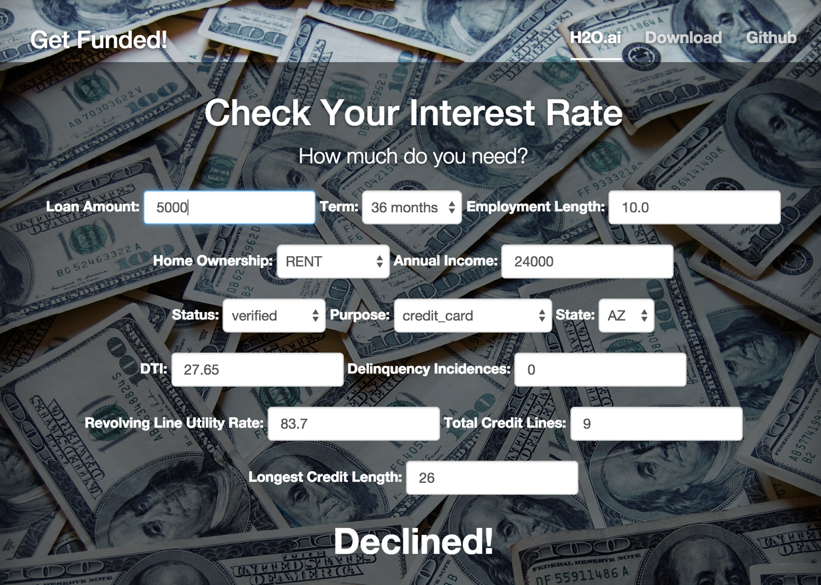
Predict Loan Defaults

